Slide 1
Challenges and Emerging Solutions in Implementing Blockchain
Ali Hashmi
Director Technology
Artificial Intelligence Lead Middle East
© Deloitte & Touche Middle East Ltd. – All rights reserved.

Slide 2
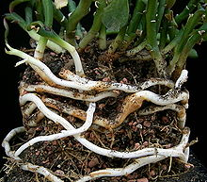
Rhizome
Tree: organized in systematic and hierarchical principles
Rhizome: Goal is to uproot the tree
Any point can be connected with any other
Entire world becomes a market
Opening the world
Goal: Enrichment
World becomes the horizon
Notes:
https://en.wikipedia.org/wiki/Tree#/media/File:Ash_Tree_-_geograph.org.uk_-_590710.jpg
https://en.wikipedia.org/wiki/Rhizome#/media/File:Euphorbia_rhizophora2_ies.jpg

Slide 3
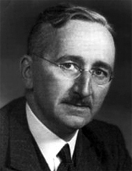
A new organizational structure
New way of value creation— shift to logic
“If we possess all the relevant information, if we can start out from a given system of preferences, and if we command complete knowledge of available means, the problem which remains is purely one of logic.”
The Use of Knowledge in Society - Hayek (1945)
Notes:
Hayek's article argues against the establishment of a Central Pricing Board (advocated by Lange) by highlighting the dynamic and organic nature of market price-fluctuations, and the benefits of this phenomenon.^{[5]} He asserts that a centrally planned economy could never match the efficiency of the open market because what is known by a single agent is only a small fraction of the sum total of knowledge held by all members of society. A decentralized economy thus complements the dispersed nature of information spread throughout society.^{[6]} In Hayek's words, "The marvel is that in a case like that of a scarcity of one raw material, without an order being issued, without more than perhaps a handful of people knowing the cause, tens of thousands of people whose identity could not be ascertained by months of investigation, are made to use the material or its products more sparingly; that is, they move in the right direction." The article also discusses the concepts of 'individual equilibrium' and of Hayek's notion of the divide between information which is useful and practicable versus that which is purely scientific or theoretical.^{[5]}
https://en.wikipedia.org/wiki/The_Use_of_Knowledge_in_Society

Slide 4
Blockchain: fat protocol
A stack with "fat" protocols and "thin" applications
Application Layer
Application Layer
Protocol Layer
Value captured
Protocol Layer
Non-blockchain
Blockchain

Slide 5
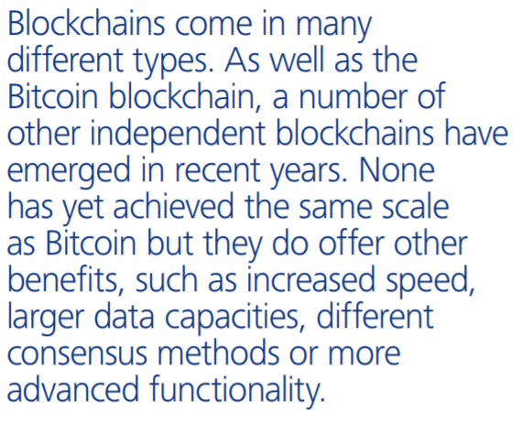
What alternatives are there to the Bitcoin blockchain
Blockchain in a state of evolution

Slide 6
Challenges
Obstacles of Blockchain Applications
Scalability
Privacy
Perceived costs
Consensus mechanisms
Trust of technology
Legally Binding
Opposing Standards (for example GDPR)

Slide 7
Costs and effort for technical integration
Indicative average costs
Integration Costs | 25 days of Senior Developer
Infrastructure Costs (Node)
On-cloud | ~$500 per month
On-Premise | ~$400 per month (48 month cycle) Hardware security module (HSM) ~$125-500 per month (48 month cycle)

Slide 8
Challenges
Obstacles of Blockchain Applications
Scalability
Privacy
Perceived costs
Consensus mechanisms
Trust of technology
Legally Binding
Opposing Standards (for example GDPR)

Slide 9
Challenges
Obstacles of Blockchain Applications
Scalability
PoW → PoA, PoS
Game theoretic approaches
Privacy
On chain, Off chain
ZKP
Homomorphic encryption
Distributed Hashtables
“If we possess all the relevant information, if we can start out from a given system of preferences, and if we command complete knowledge of available means, the problem which remains is purely one of logic.”
- Hayek (1945)
Notes:
The time is taken to put a transaction in the block.
The time is taken to reach a consensus.

Slide 10
Blockchain consensus mechanisms
The finality of each new block is agreed via a shared consensus mechanism
PROOF OF WORK
PROOF OF STAKE
PROOF OF AUTHORITY
PRACTICAL BYZANTINE FAULT TOLERANCE
Bitcoin
Ethereum
Perform a mathematical algorithm that is difficult to do, but easy to verify if correct
Ethereum – 2018
Staking a token(s) to perform correct mining in return for rewards from the network. If you forge a transaction, your tokens are taken away as a penalty
Ethereum – Distributed Only
Round-robin validation of blocks by authorised validators/nodes
Hyperledger
67% of the authorised validators/nodes must agree on the validity of a block

Slide 11
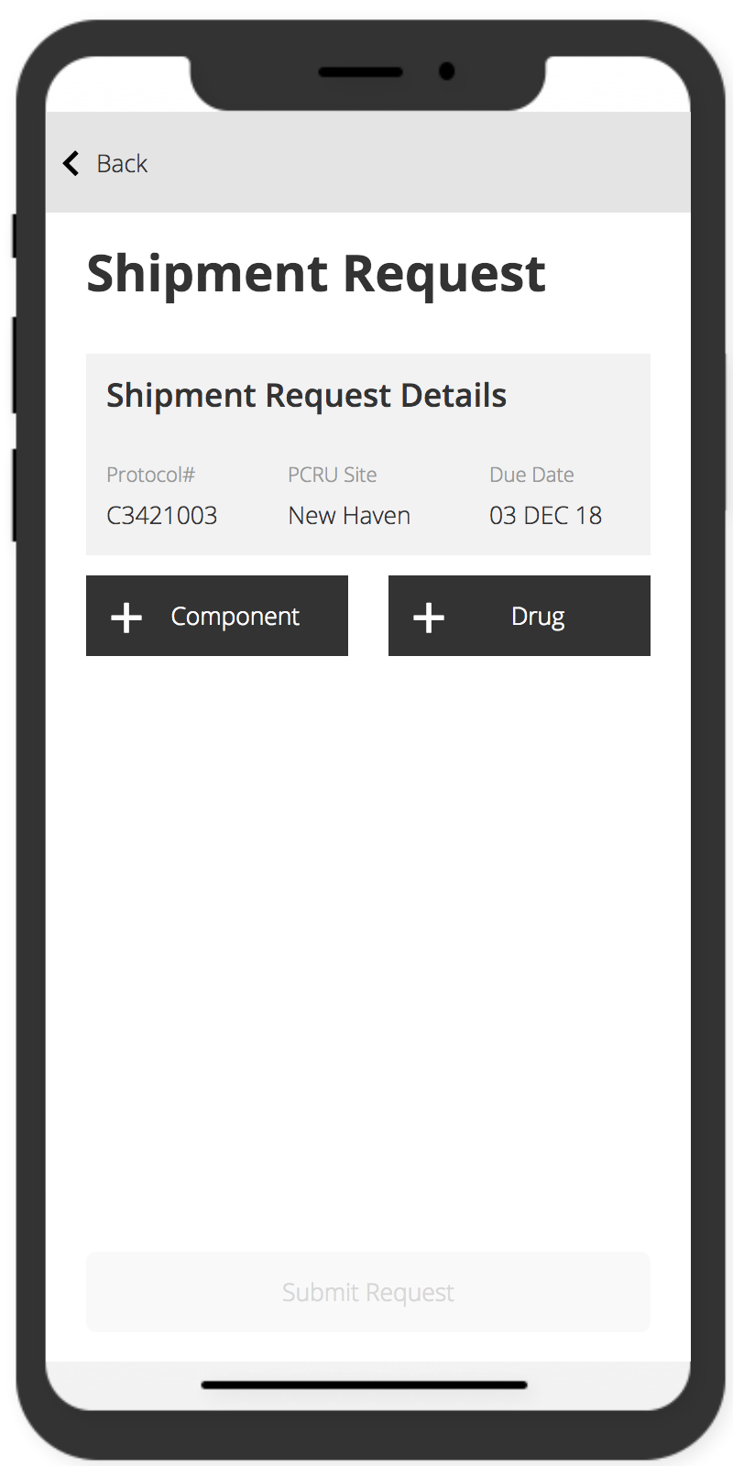
High level blockchain public decentralized architecture
Completely open in terms of access and authority
Public Blockchain Network
(Nodes can be Cloud-based)
Node
Consumers
Public Interface
Node
Node
Reference API and UI
B2B Consumer
Node
Node
Anyone can join and run the network
Notes:
Discussion points:
Problems with a public chain include: potential loss of control and poor scalability.
Loss of control – Once the platform goes live, no single entity no control on the platform. The platform will need to agree
Poor scalability – Similar to bitcoin, the TPS is low due to public mining

Slide 12
High level blockchain public semi-decentralized architecture
Restricted authorities but open access
Public Blockchain Network
(Nodes can be Cloud-based)
Node
Consumers
Public Interface
Node
(PoA)
Node
Reference API and UI
B2B Consumer
Node
Node
Only nodes approved by master node can join
Notes:
Discussion points:
Proof Of Authority (PoA) mode which will deliver sufficient scale and security while still being an open ledger

Slide 13
High level blockchain permissioned distributed architecture
Restricted Access
Cloud Environment
Blockchain Network
Reference API and UI
Node 0
Consensus Mechanism
(Controlling entity)
Consumers
Data Repository
(Off Chain)
Node 1
CA
(Certificate Authority)
(Controlling entity)
Consumers Web Users
Notes:
Discussion points:
Private & Public blockchain considerations need to be discussed on each criteria regarding customer service, risk reputation, financial chargebacks and the establishment of how industry consortia could or should be employed in a future market.
While this can hide data, no version of this could be truly global.
For all practical purpose, this solution is a distributed version of centralized database will multiple access controls and limited transparency

Slide 14
Evolution of consensus algorithms: alternatives to PoW
Game theoretic approaches to consensus (informed by Nash equilibrium etc.)
Incentivizing participation rather than selfish or greedy algorithms
Stakeholders can use mutually beneficial strategies

Slide 15
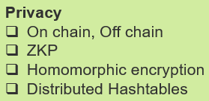
Blockchain solution: technology stack
API layer, Smart Contracts layer, Blockchain and DB data layer, Off-chain key management
High Level Architecture
Key features
Production integration
OFF CHAIN Storage
HSM
Production Integration
Integration with existing systems
API Layer
RESTful API (Blockchain API – Java Spring Boot application)
Encryption layer
Layer that manages encryption and decryption from smart contracts
Smart Contracts
Processing and validating of business logic, built on templates
Blockchain Node
Blockchain network
Underlying Infrastructure
VMs/OS/Servers/Network/Cloud
Off Chain Storage
Storage of keys in a Hardware Security Module
Database layer to persist sensitive information
API Layer
Encryption layer
Other off-chain data
Smart Contract Templates,
Application Framework
Smart Contracts
Blockchain Node
Underlying Infrastructure

Slide 16
Evolution of privacy: decentralized computation platform with guaranteed privacy
Enigma is designed to connect to an existing blockchain and off-load private and intensive computations to an off-chain network.
public
${Op}_{i}$
Blockchain
Enigma
shares
encrypted data
public data
Off chain data
f : x → y
private
Notes:
Notes:
Think of it like a puzzle. Each node holds a piece to this puzzle, but each piece is useless without all of the others. Moreover, the nodes’ operators don’t know the picture that all of the pieces make. The user accessing Enigma to store her data, however, does know what the picture is, and with it, she can retrieve all of the pieces to reconstruct this picture when she wants.
Enigma can likewise be used for off-chain storage, whether this data is encrypted or not. Thus, Enigma presents an off-chain storage option and a scalability solution, for it can be used to process heavy/intensive computations that are still publicly verifiable on the blockchain.
https://coincentral.com/enigma-beginners-guide/

Slide 17
?

Slide 18
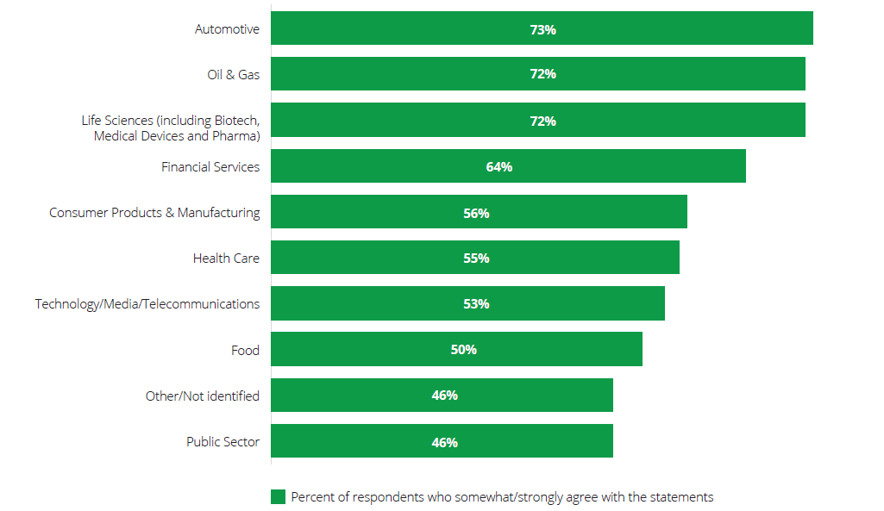
Perceived disruption of blockchain technology – by industry
Q: Blockchain technology will disrupt my organization’s industry – What is your level of agreement or disagreement with this statement regarding blockchain technology?
Deloitte’s 2018 global blockchain survey | Findings and insights

Slide 19
What application areas?
Taxonomy of Blockchain Applications
Financial Transactions
Smart Contracts
Data Management
Storage
Communication
Ranking
Lavazova, Olga, Tobias Dehling, and Ali Sunyaev. "From Hype to Reality: A Taxonomy of Blockchain Applications." Proceedings of the 52nd Hawaii International Conference on System Sciences (HICSS 2019). 2019.
Notes:
What application areas fit blockchains with what technical characteristics? We develop a taxonomy, which comprises six blockchain application areas based on:
Reading access Writing access Main consensus mechanism Anonymity level Event handling Data exchange type Encryption History retention

Slide 20
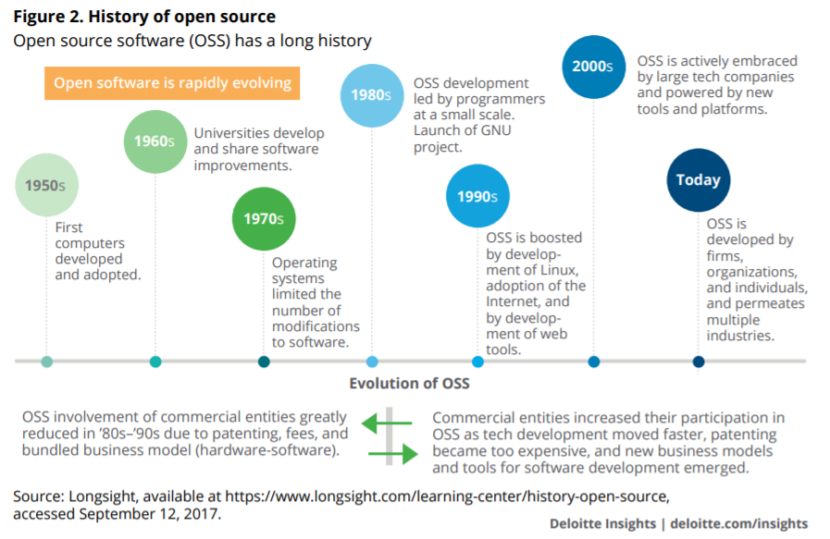
Evolution of blockchain
Disruptive innovation has fostered an ever-increasing sharing economy, which has shifted important software development back to opensource platforms. Blockchain evolution is largely about the “community.”

Slide 21
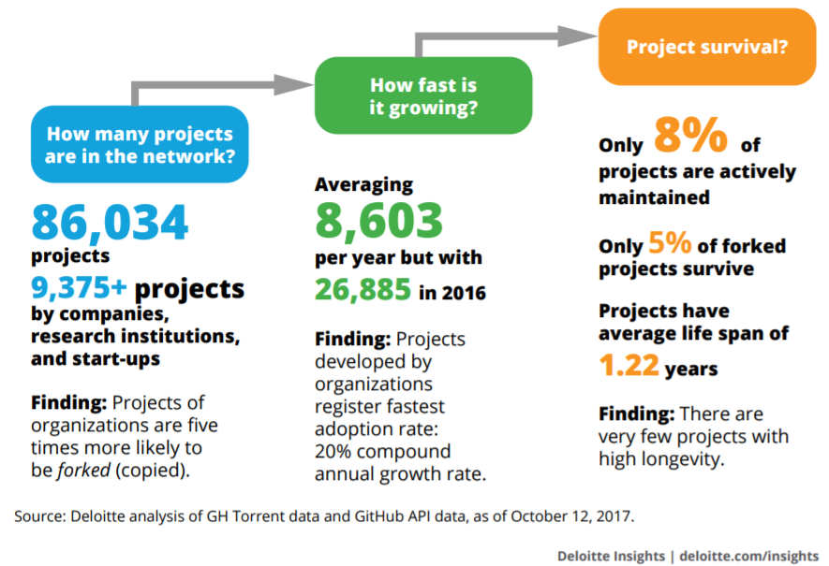
Evolution of blockchain
Blockchain on GitHub

Slide 22
TPS
Comparison of various platforms (*indicative)
 | #1 - Public Decentralized |  | #2 - Public Semi-decentralized |  |  | #3 - Permissioned Distributed
 | Ethereum (Public) | EOS | Ethereum (PoA) | VeChain | NEO | Fabric | Corda
Scalability | ~15 tps | ~1000tps | > 400 tps | ~1000tps | ~1000tps | ~1000tps | ~1000tps
Developer Ecosystem | Large | Medium | Large | Medium | Medium | Large | Medium
Maturity | > 4 years | < 1 year | > 4 years | < 1 year | < 1 year | 3 years | 3 years
Legacy Integration | Easy | Hard | Easy | Easy | Hard | Easy | Easy
Security | Hardened | Testing | Hardened | Hardened | Testing | Hardened | Hardened
Interoperability | Proven | Proven | Proven | Proven | Unproven | Proven | Proven
Standards | Exist | Don’t exist | Exist | Don’t exist | Don’t exist | Exist | Don’t exist
Privacy | Build-on | Build-on | Build-on | Build-on | Build-on | Built-in | Built-in
Confidential Inventory | No | No | No | No | No | Yes | Yes
Globally Enabled | Yes | Yes | Yes | Yes | Yes | No | No

Slide 23
This document has been prepared by Deloitte & Touche (M.E.) for the sole purpose of providing a proposal to the parties to whom it is addressed in order that they may evaluate the capabilities of Deloitte & Touche (M.E.) to supply the proposed services.
The information contained in this document has been compiled by Deloitte & Touche (M.E.) and includes material which may have been obtained from information provided by various sources and discussions with your management which has not been verified or audited. This document also contains material proprietary to Deloitte & Touche (M.E.). Except in the general context of evaluating our capabilities, no reliance may be placed for any purposes whatsoever on the contents of this document or on its completeness. No representation or warranty, express or implied, is given and no responsibility or liability is or will be accepted by or on behalf of Deloitte & Touche (M.E.) or by any of its partners, members, employees, agents or any other person as to the accuracy, completeness or correctness of the information contained in this document or any other oral information made available and any such liability is expressly disclaimed.
Other than as stated below, this document and its contents are confidential and prepared solely for your information, and may not be reproduced, redistributed or passed on, directly or indirectly, to any other person in whole or in part. Therefore you should not refer to or use our name or this document for any other purpose, disclose them or refer to them in any prospectus or other document, or make them available or communicate them to any other party. If this document contains details of an arrangement that could result in a tax or National Insurance saving, no such conditions of confidentiality apply to details of that arrangement (for example, for the purpose of discussion with tax authorities). In any event, no other party is entitled to rely on our documentation for any purpose whatsoever and thus we accept no liability to any other party who is shown or gains access to this document.
This document is not an offer and is not intended to be contractually binding. Should this proposal be acceptable to you, and following the conclusion of our internal acceptance procedures, we would be pleased to discuss terms and conditions with you prior to our appointment.
Deloitte refers to one or more of Deloitte Touche Tohmatsu Limited, a UK private company limited by guarantee (“DTTL”), its network of member firms, and their related entities. DTTL and each of its member firms are legally separate and independent entities. DTTL (also referred to as “Deloitte Global”) does not provide services to clients. Please see www.deloitte.com/about for a more detailed description of DTTL and its member firms.
Deloitte & Touche (M.E.) is a member firm of Deloitte Touche Tohmatsu Limited (DTTL) and is a leading professional services firm established in the Middle East region with uninterrupted presence since 1926.
© 2018 Deloitte & Touche (M.E.). All rights reserved.

